Slide 1
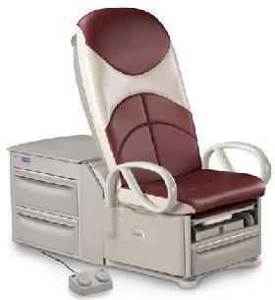
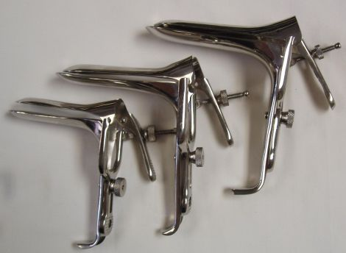
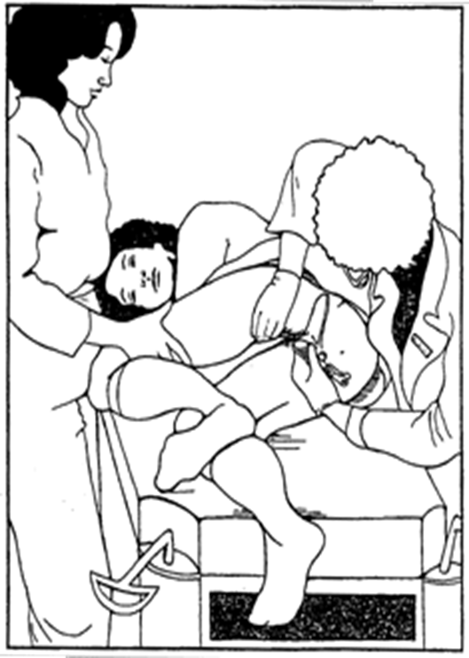
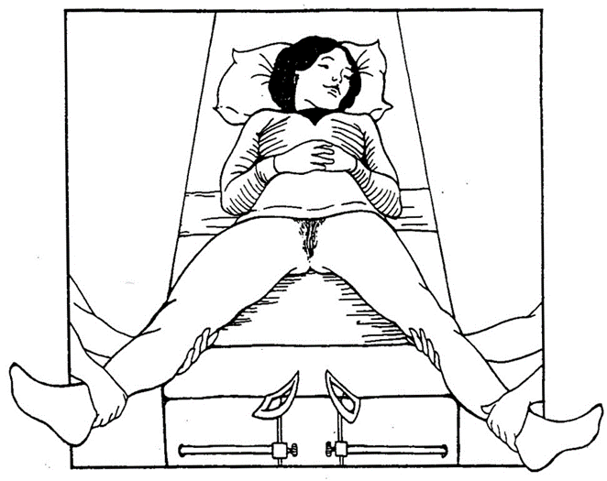
Gyn Exam Basics in Patients with Disabilities Dr Arlene Smalls Ob Gyn, Christiana Care
Gyn Exam Essentials: Patient Comfort, Have a plan of care for the visit
Team work (Provider, Patient, Staff)
Patient Positioning: Traditional Back, M or V position, Diamond or Side, or the Reclined Wheelchair
Empty Bladder
ACOG 2011
Equipment: Exam Bed with Adjustable Height Leg Supports optional
Patient Lift / Transfer equipment
Speculum(s): Graves vs Pederson

